Slide 1
Studying relationship of Pupil diameter with Emotion perception
IP Summer Sem 2023
Guide: Dr. Sonia Baloni Ray
Acknowledgements: Mr. Sangramjit Maity
Presenters: Arha Samanta & Abhishek Acharya Date: 13 July 2023

Slide 2

Introduction
Dataset
A dataset of 38 participants’ Physiological data was provided, that contained the image name, response key, response time and the pupil diameter values. The images were divided as Happy (E1), Angry (E2) and Neutral (E3), thus resulting in three types of faces per participant.

Slide 3
Introduction
Aim
We aim to use this whole dataset to extract important features like: Latency, Minimum Amplitude and Gradient. This will be fed into a ML Model to predict the face shown to a participant, by taking input just the pupil diameters.

Slide 4

Goals
Objective
Our objective is to study the behaviour of pupil, whether it constricts or dilates, when shown a Happy, Angry or Neutral face. For this, we require to extract various features like Latency, Minimum Amplitude and Gradient from the given dataset. However, this must be done only after Preprocessing the dataset, to remove any external noise and perform curve smoothening.

Slide 5
Methodology
Preprocessing
We began by preprocessing the time series data, including loading the data into pandas DataFrames, handling missing values, and ensuring the data was in the correct format for analysis.
Latency
We aimed to identify the latency in the time series data by analyzing consecutive columns and performing statistical tests. We also used sliding window method to find the latency. The goal was to detect significant changes in values, i.e., take values below 0.05.
Amplitude and Gradient
We sought to calculate the amplitude in the time series data by identifying the minimum and maximum values in each row. Additionally, we aimed to calculate the gradient at these points to assess the rate of change in the data.

Slide 6
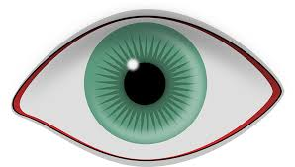
Work Done

Slide 7
Read the related Research Papers, and study the code for the Model already created.
Detected a Bug, where the Preprocessing was done wrongly. Instead of whole dataset, it was calculated on a slice, which was found to be wrong.
Understood how to do T-Test for extracting Latency, and take only the values which are p value less than 0.05.
20.05.2023
16.06.2023
20.06.2023
24.06.2023
29.06.2023
Tried to do Preprocessing and Curve smoothening. Then find the features like Latency and Amplitude.
Tried to Plot the time series graph, but got a different graph to the one expected.

Slide 8
Given a newly constructed dataset, where only the correct responses were present. Also, the Preprocessing pipeline was corrected and given to us.
Tried to find the features like Amplitude and Gradient. Faced a problem to get T- Test values less than 0.05 for Latency.
Based on the some of the correctly extracted features, like Amplitude, Gradient; the correct time series average graph; and identifying a small Bug, we decided to conclude our IP Project.
03.07.2023
05.07.2023
07.07.2023
09.07.2023
12.07.2023
Found the exact same graph as expected, after newly preprocessing the dataset, and taking means. Also, we took the data only for participants with more than 70 % accuracy.
Due to applying a different method than sliding window trial wise, was not able to get the expected Latency values.

Slide 9
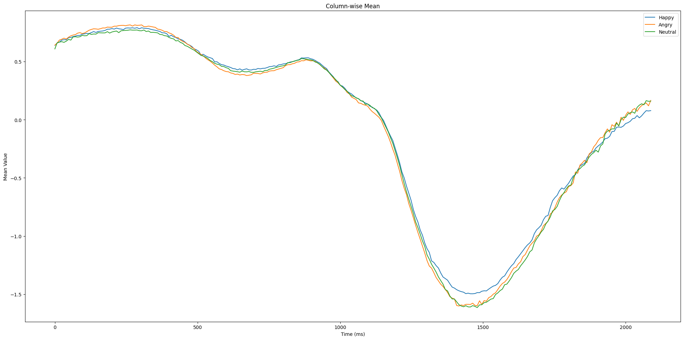
Results Achieved

Slide 10
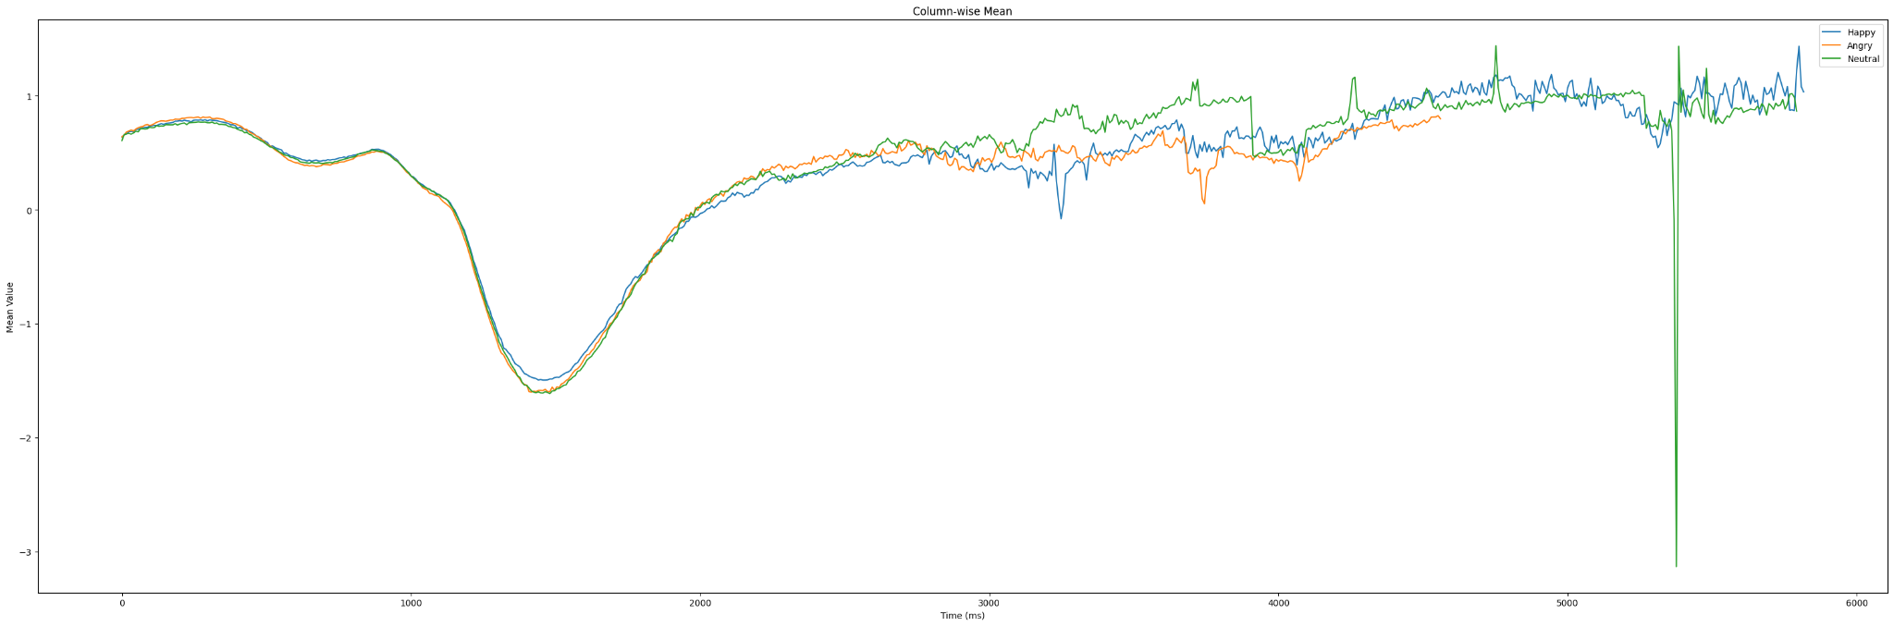

Slide 11
Graphs Explanation
The first graph shows the Mean values vs Time in ms, for the average of all the Happy, Angry and Neutral faces. These are for the first 262 columns, or till around 2500 ms. We can see that, there is significant drop of values and then a steep rise, which reflect the fact the pupil dilates and constricts after seeing a type of face.
In the second graph, the entire dataset or all columns are taken, so all the values can be seen. Towards the end of experiment, the values are extremely noisey to conclude anything.

Slide 12
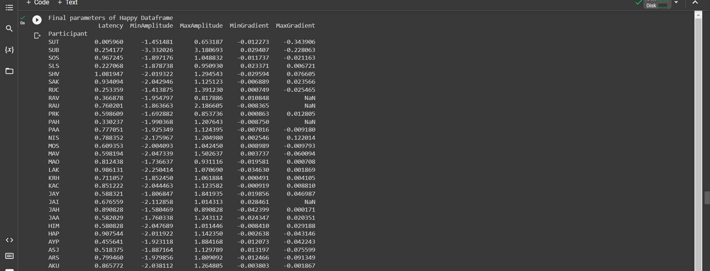
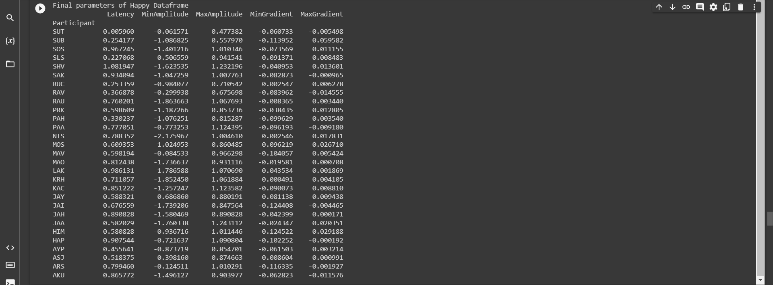
Features Obtained
For whole dataset
For t1 to t162, i.e., 0 to 1300 ms

Slide 13
Individual Contributions
Arha Samanta
Abhishek Acharya
Plotted the wrong graph based on previous dataset, and old Preprocessing pipeline.
Then, plotted the correct expected graph, after a new dataset and preprocessing pipeline was given.
Found the latency using sliding window of size 5 method.
Documented the whole code for future reference.
Did Curve Smoothening using Moving Average method.
Extracted the mean dataframe across all participants for each type of face, that was used to mimic the expected graph.
Found the min and max amplitude, and the gradient at those points.
Found the latency by doing T-Test column-wise, but failed to get any value below 0.05 to consider.
Created this presentation, by collecting all data and details.

Slide 14
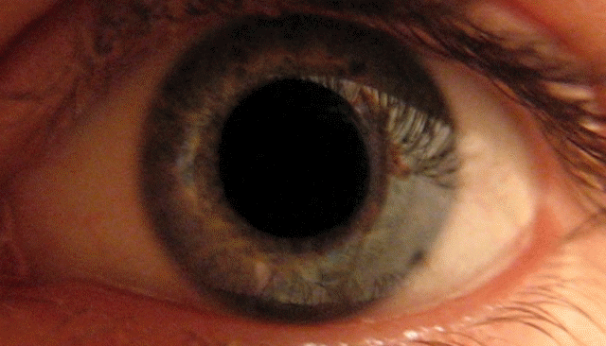
Conclusion
In this project, we successfully analyzed Pupil time series data to identify latency, amplitude and gradient. We achieved our goals of preprocessing the data, calculating latency using statistical tests and sliding window, and determining the minimum and maximum values of amplitude and gradient.
Though the latency we got may be erroneous, the graph is correctly depicting the Pupil response upon showing a type of face is as expected. The achieved results provide a valuable insights into the temporal aspects of the data.
Through collaboration, help from doctorate student and individual contributions, we were able to complete the project and gain practical experience in working with time series analysis techniques of physiometry data.

Slide 15


